Slide 1
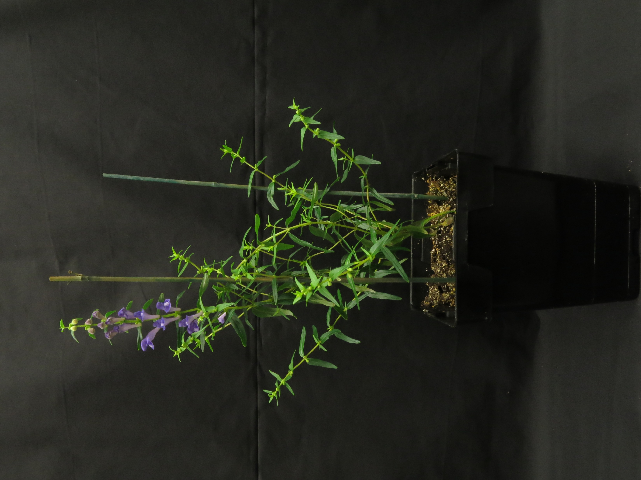
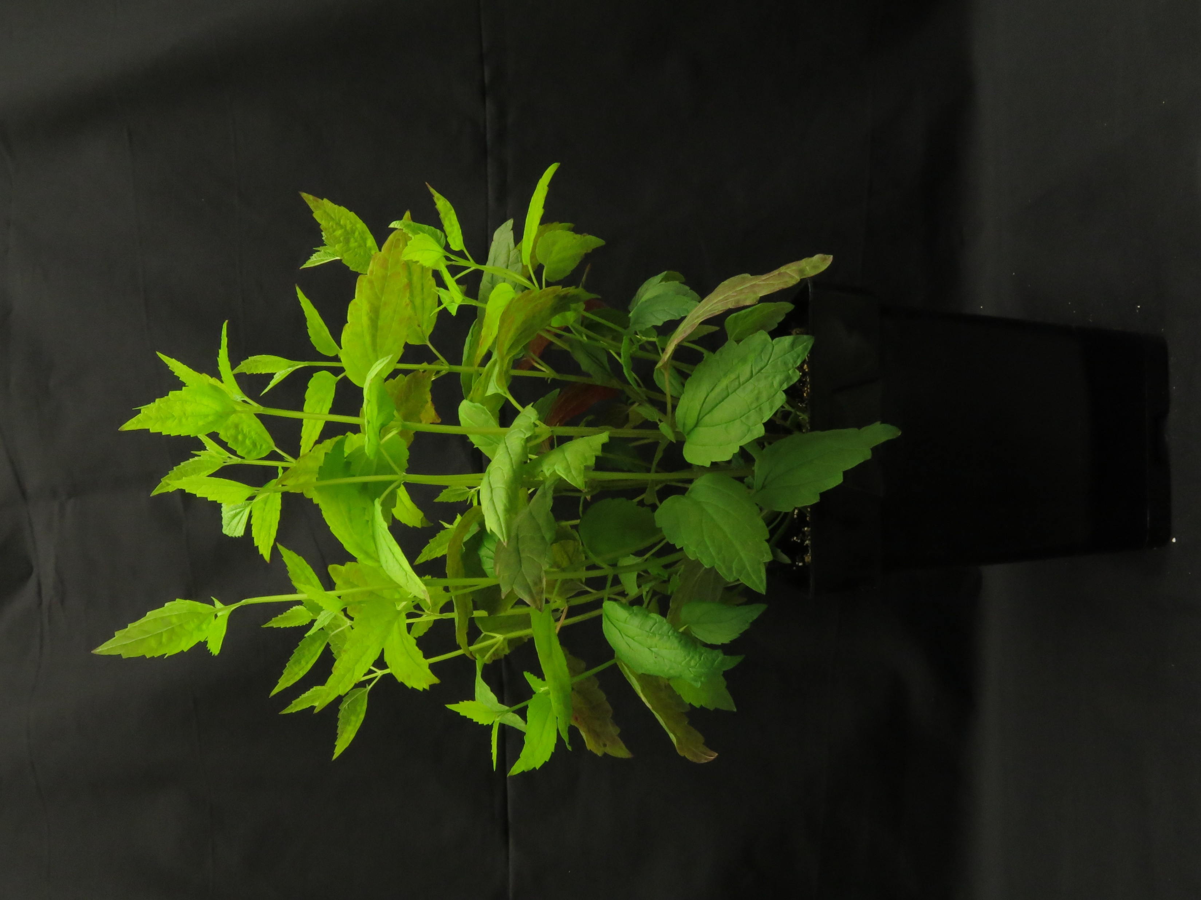
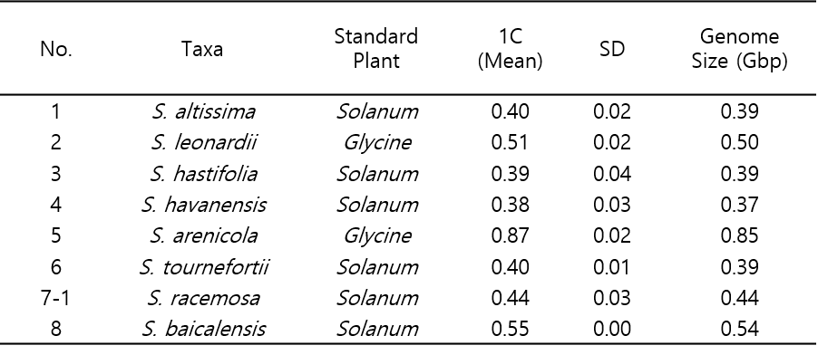
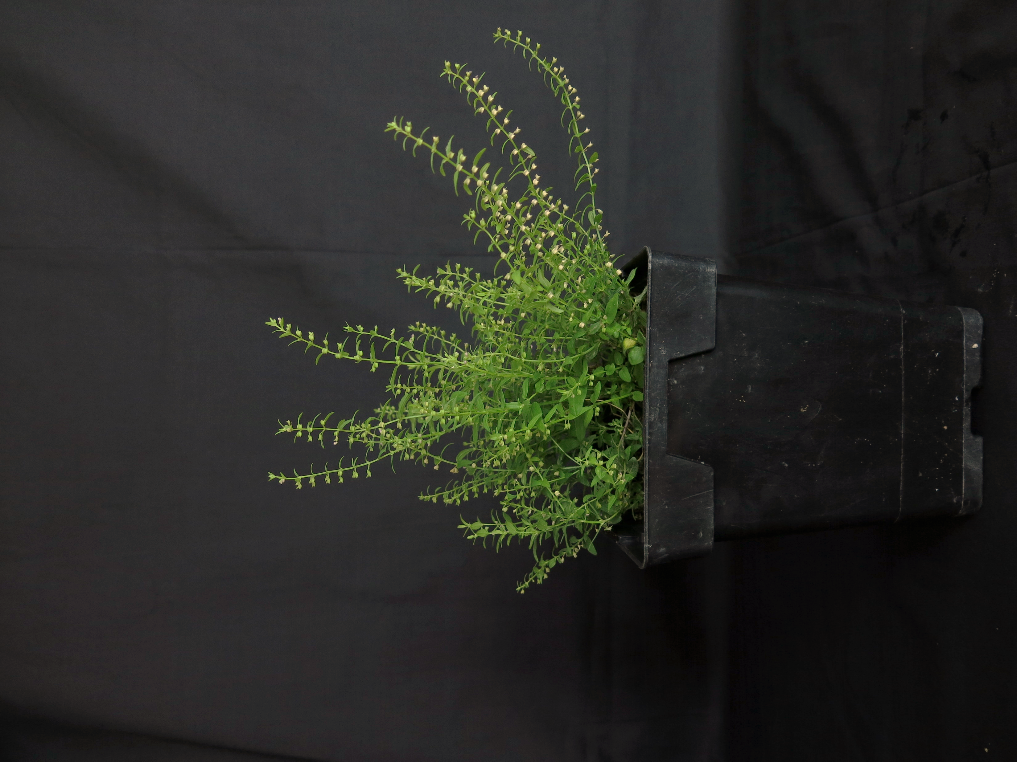
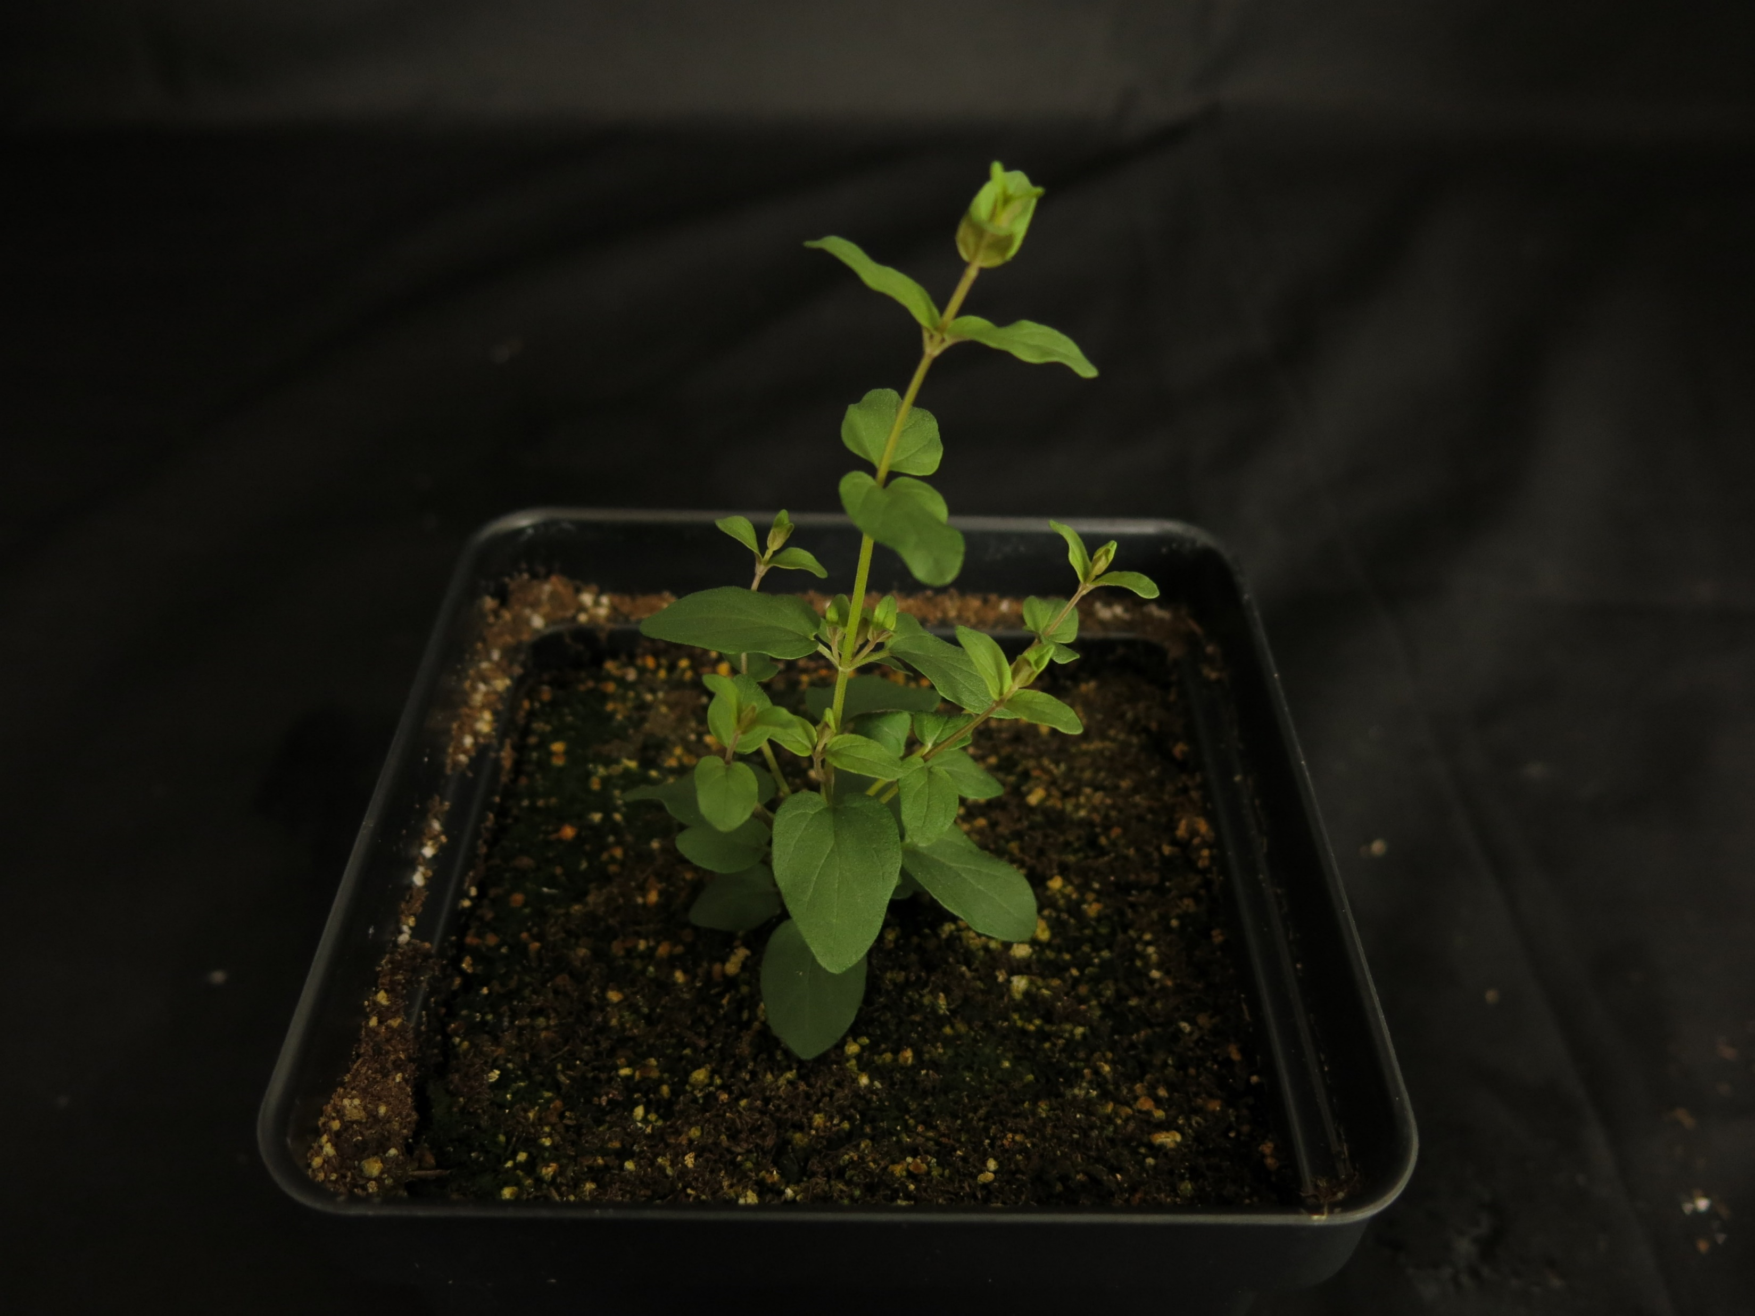
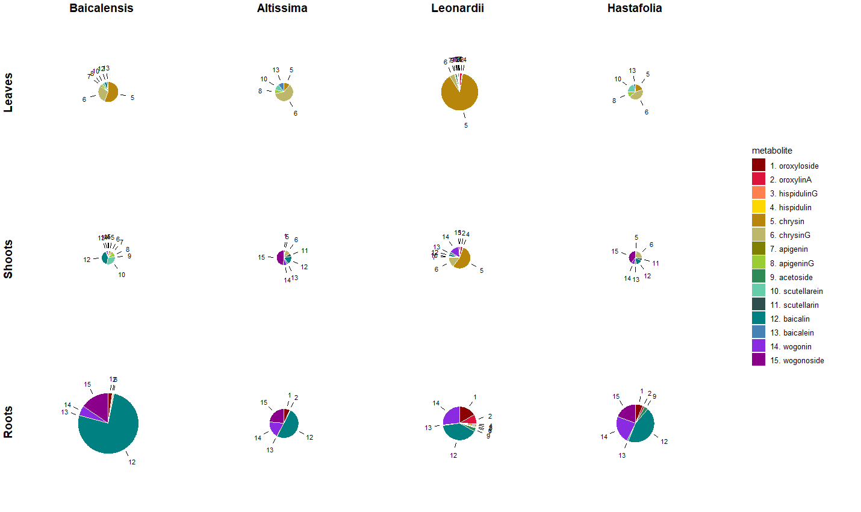
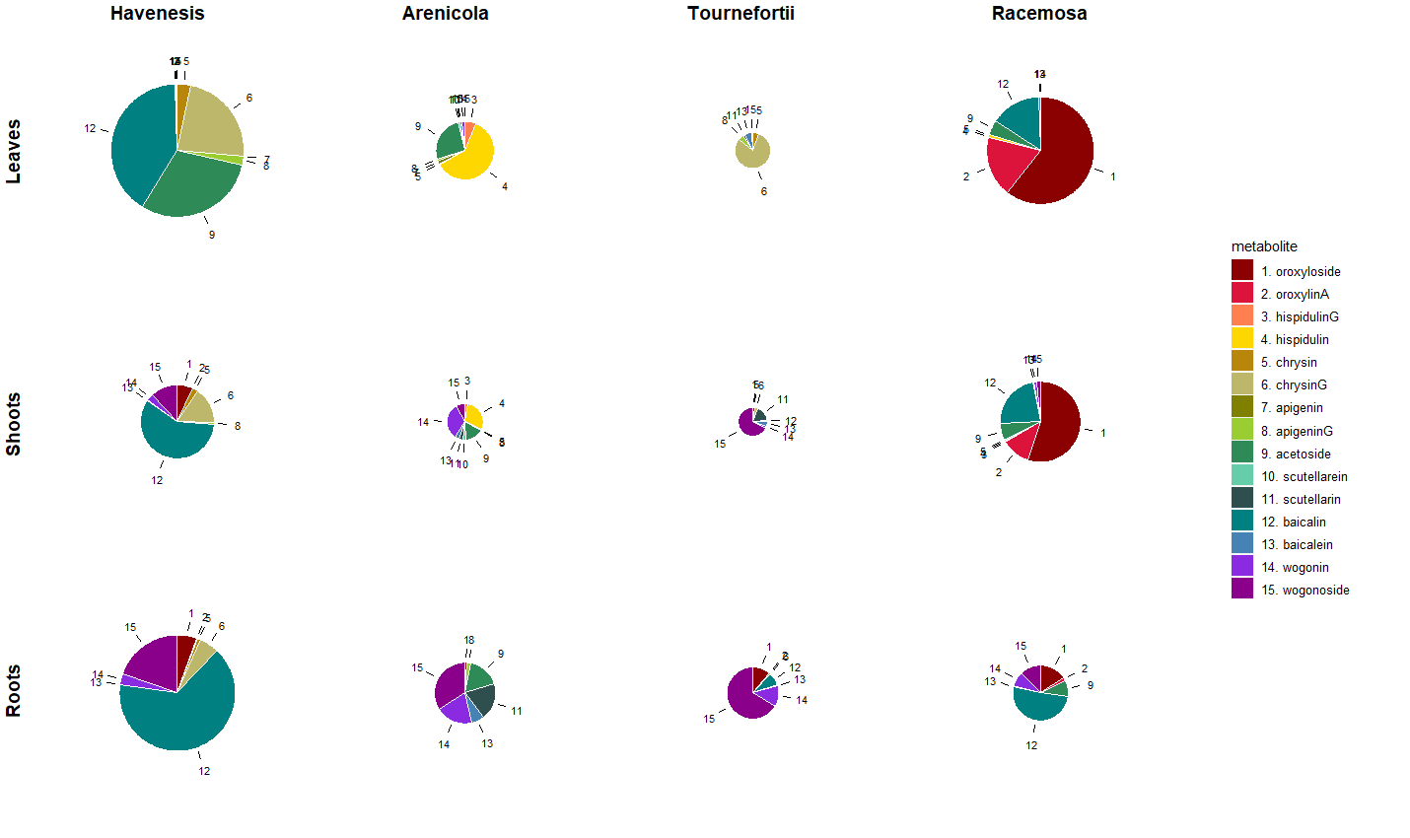
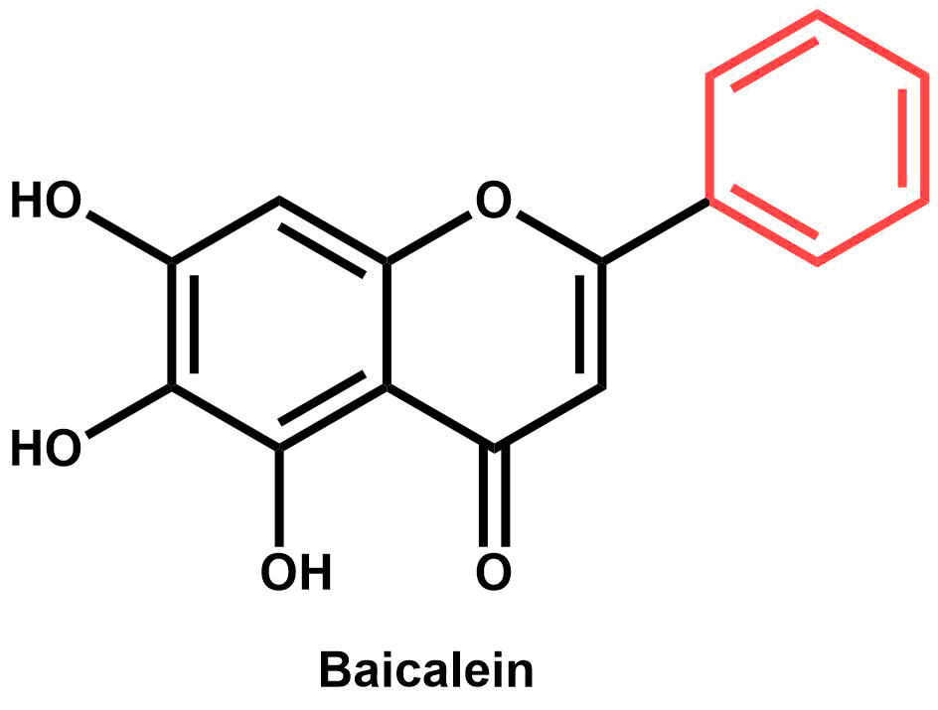
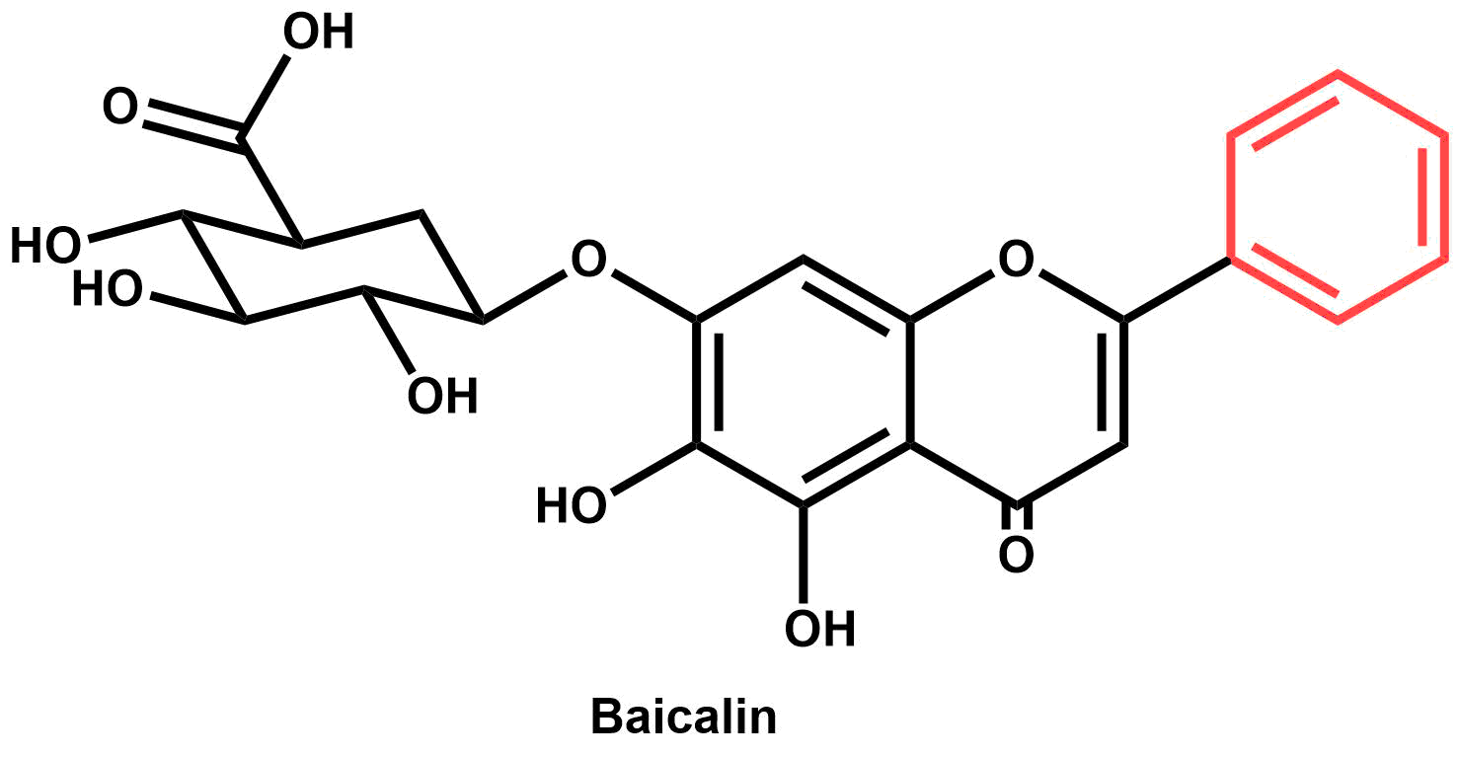
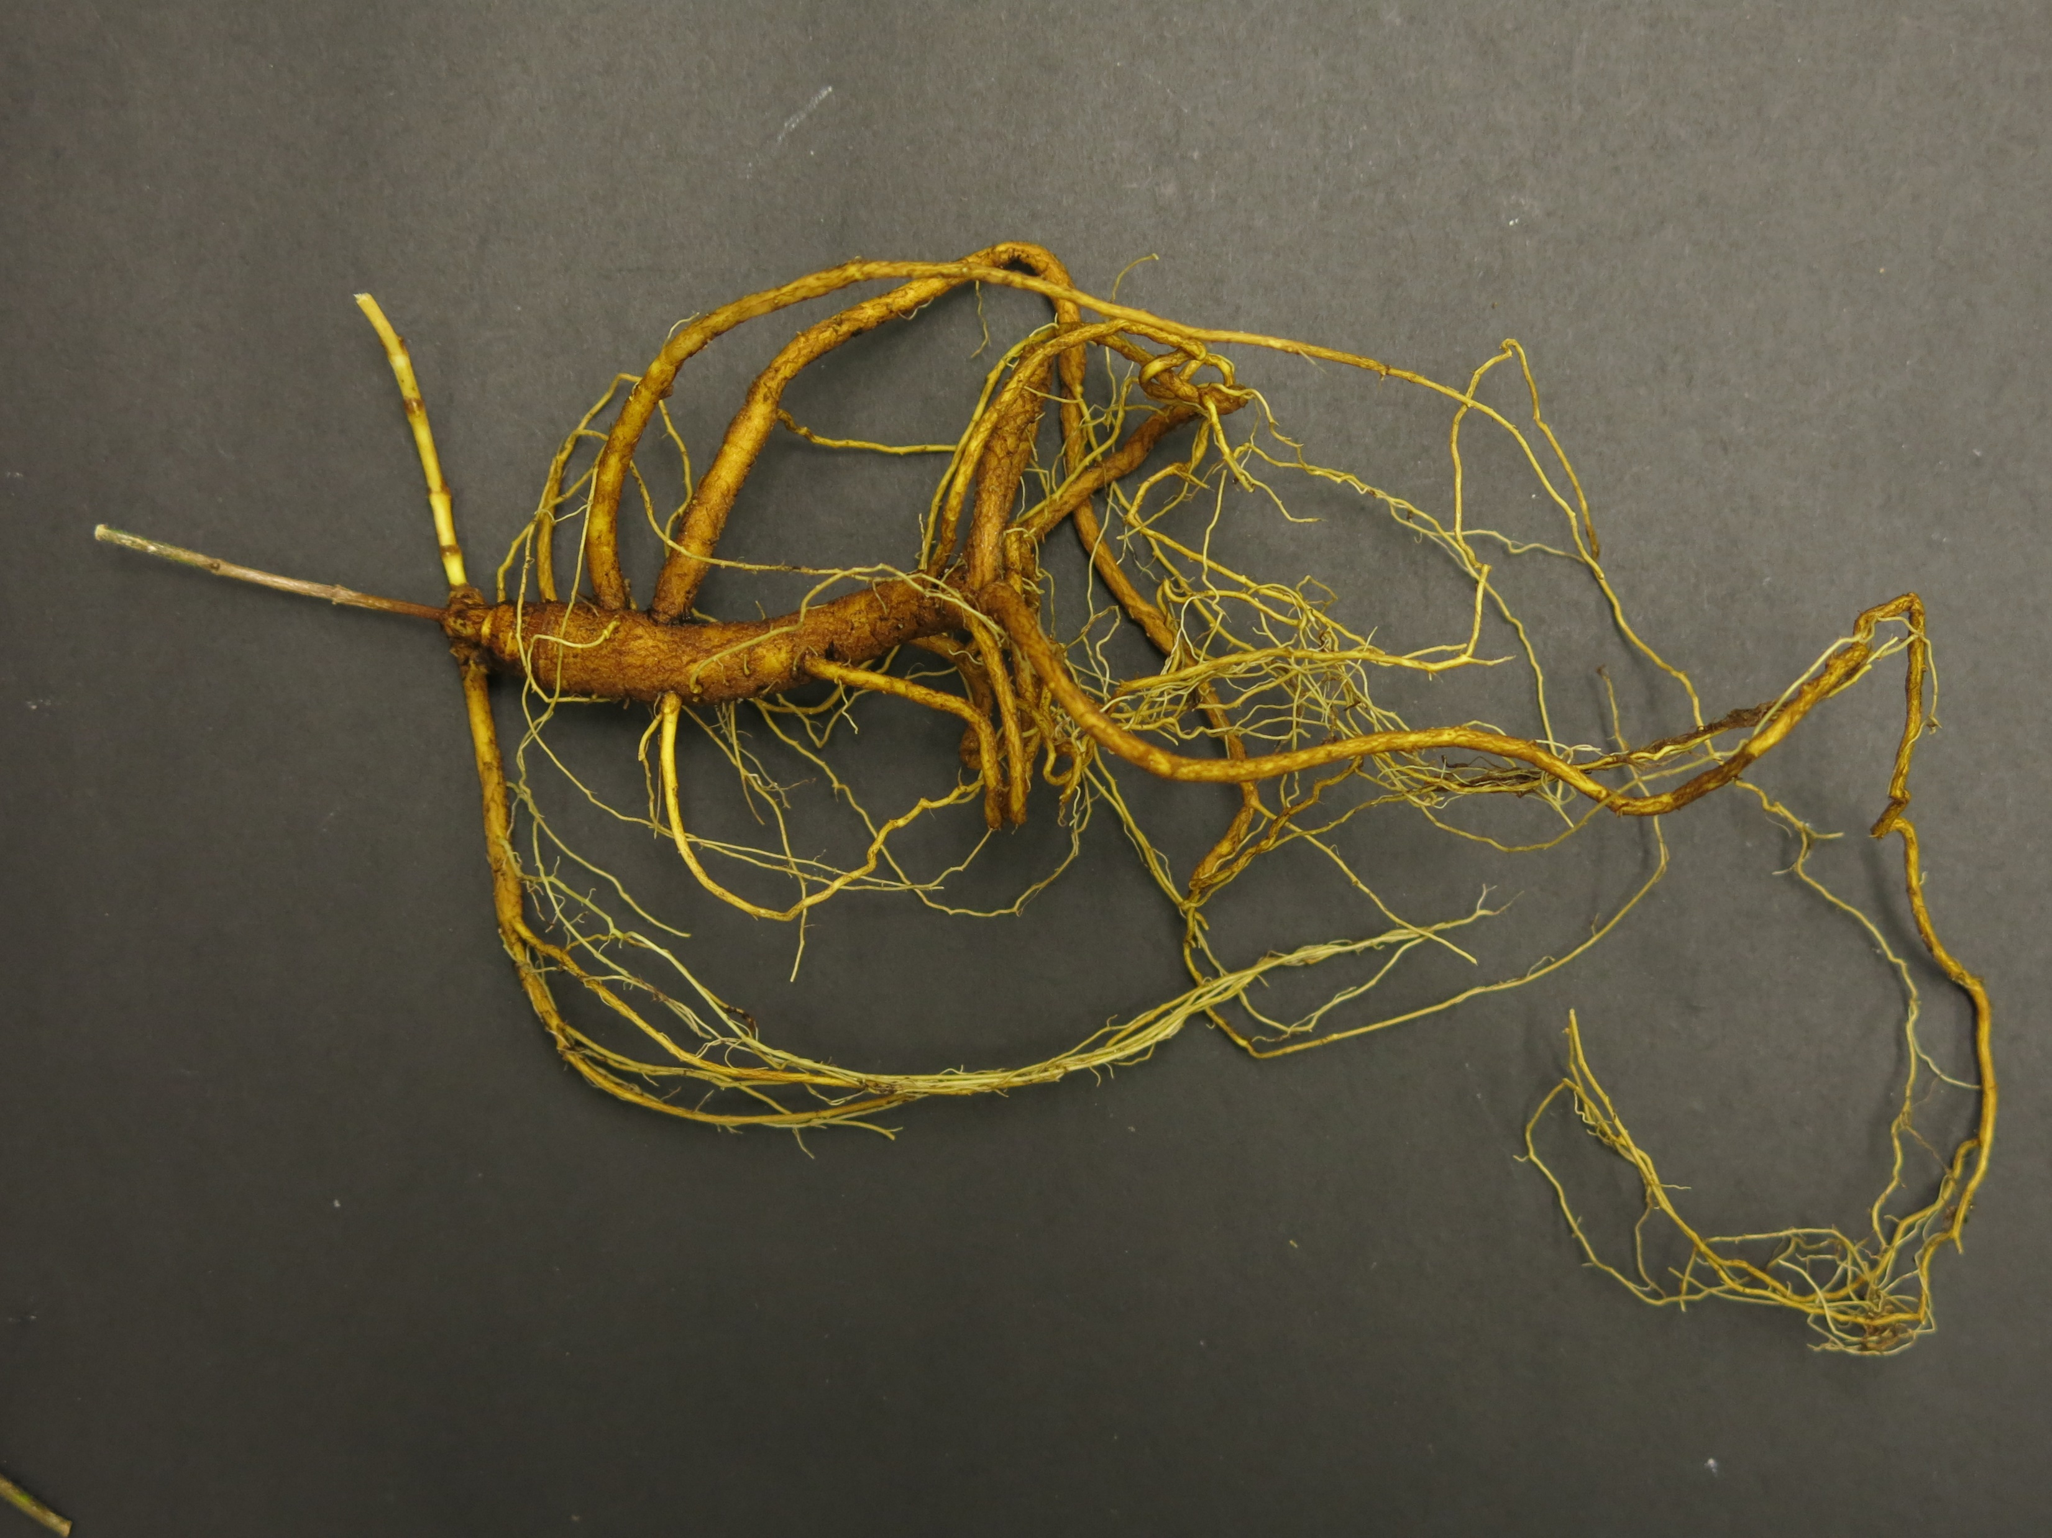
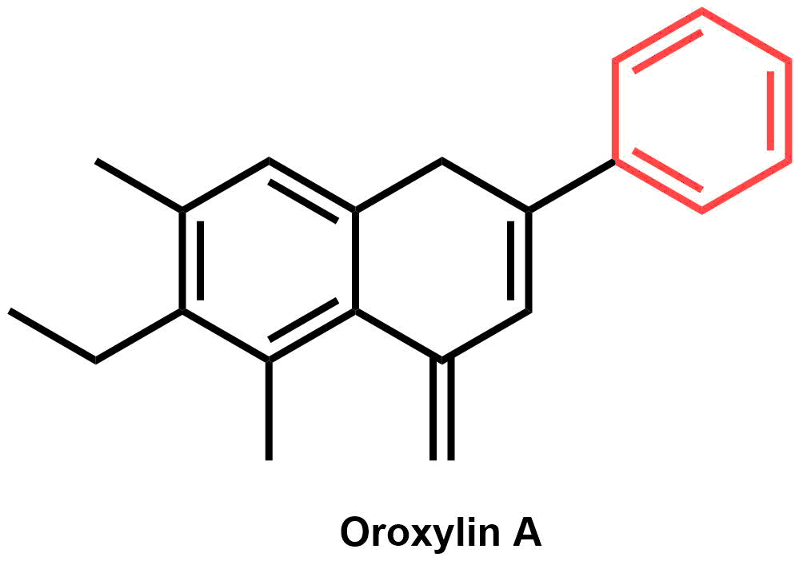
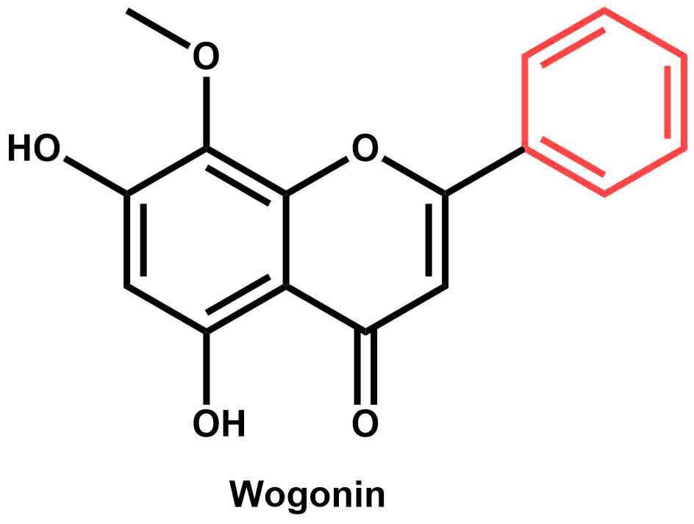
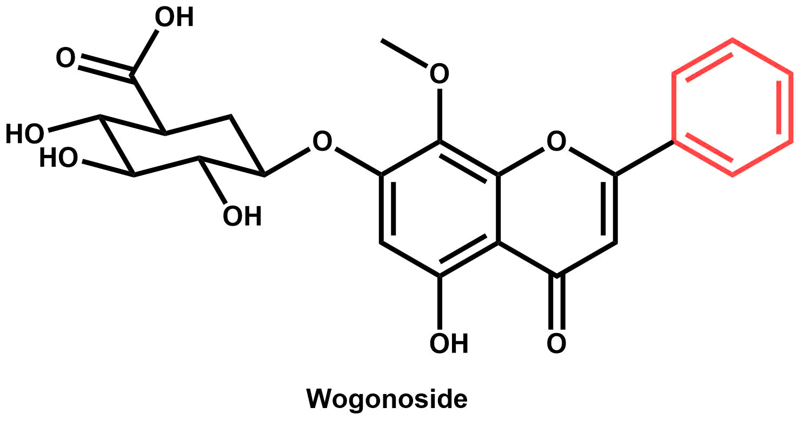

An investigation of flavonoid diversity in Scutellaria to identify species with medicinal potential
Bryce Askey, Yeong Hun Song, Yoonkyung Lee, Ru Dai, Sangtae Kim, and Jeongim Kim
Author affiliations
Methods and Results
High Performance Liquid Chromatography (HPLC) was used to perform targeted metabolite analysis on … species of Scutellaria. The concentrations of 15 medicinally relevant flavonoids were quantified from fresh and dried samples. Dried samples were prepared … concentration of 5000 ppm. Fresh samples were prepared … concentration of 1000 ppm.
Figure 3. Heatmap of herbarium samples + avg of organ-specific data
Of the … species analyzed, … were selected for further study. Root, stem, and leaf samples were taken
Table 1. Flow cytometry data
Figure 4. Scaled pie charts
Genomic size for 8 species was estimated with flow cytometry
Abstract
Scutellaria baicalensis is a medicinal plant whose root extracts have been widely used in Asian medicine for more than 2,000 years. Although S. baicalensis has been well-studied, the majority of the 470 species in the Scutellaria genus have not been analyzed. This study aims to extend the current knowledge of Scutellaria by analyzing flavonoid profiles and genome sizes of a large set of species representing the diversity in the genus. Targeted metabolite analysis via High Performance Liquid Chromatography (HPLC) was used to quantify concentrations of 15 medicinally relevant flavones. The genome sizes of eight of the species analyzed were also estimated with flow cytometry. A comparison of phytochemical profiles indicate diversity in site and identity of accumulation for multiple species when compared to S. baicalensis. Inconsistences in site of accumulation imply significant differences in biosynthetic pathway exists for several species. Researchers studying Scutellaria can use the results of this work to identify previously uncharacterized species with medicinal potential, aiding in the development of new drugs and treatments.
Background
Scutellaria baicalensis is a medicinal plant
Root extracts used in traditional Chinese medicine
Huang Qin – commercially sold powder of S baicalensis roots
The medicinal properties of S. baicalensis are well-studied
Proven medicinal effects: anti-Alzheimer’s, anxiolytic, anti-cancer, and angiogenic
Specific phytochemicals responsible have been identified
Reference genome recently completed
Proposed flavonoid biosynthetic pathway explains organ-specific accumulation
However, the Scutellaria genus contains >470 species
Little is known about the medicinal relevance of most of the genus
Phytochemical profiles are not well-studied/not studied at all
Goal: Analyze a large set of Scutellaria plants representing the diversity in the genus to identify species with medicinal potential for further study
Objectives:
Identify species of interest by chemically analyzing total (i.e. not organ-specific) samples
Analyze organ-specific samples from species of interest to determine site of accumulation
Estimate genome size for species of interest to evaluate ease of further genetic study/improvement
A.
B.
Table 1. Genome sizes for species of interest
C.
Figure 1. Morphological differences between (A) S. baicalensis, (B) S. lateriflora, and (C) S. racemosa plants.
Baicalein:
anti-Alzheimer’s and anxiolytic activity (Shang et al., 2005; Gasiorowski et al., 2011; Awad et al., 2003; Cole et al., 2007)
Baicalin:
anti-cancer and anxiolytic activity (Zhao et al., 2016;
Awad et al., 2003; Cole et al., 2007)
Figure 5. Scaled pie charts for organ-specific data
Conclusions
Discrepancies in proposed biosynthetic pathway for S. baicalensis and metabolite profiles for … imply …
Genome size is similar to S. baicalensis for 7 of the 8 species analyzed
Oroxylin A:
anti-Alzheimer’s activity (Shang et al., 2005; Gasiorowski et al., 2011)
References
Wogonin:
anti-cancer, anxiolytic, and anti-Alzheimer’s activity (Zhao et al., 2016; Cole et al., 2007
Wogonoside:
anti-cancer activity (Zhao et al., 2016)
Use colored dots to label medicinal properties, and create key
Underline headings with blue line
Acknowledgements
Figure 2. S. baicalensis root extracts contain a variety of metabolites with medicinal properties.

